Slide 1




DES CSI: Aiding NEPA Decisions
Karen Mynhier – KYTC District 9
Phil Logsdon – Lochner
Mitch Green - HMB
Notes:
Purpose and Need is Really Important!
Sell upcoming P&N Training
Mention AASHTO Practitioners Guide 07 – Defining P&N and Range of Alternatives
A few issues were identified as a result of the audit, several of which were directly related to adequate justification and documentation of the project.
It is common practice to append the Design Executive Summary to the CE1 documents because it contains information that is important to the understanding of the project, as well as, the reasoning for decisions made for the project.
One item identified in the FHWA audit was that more of the information from the DES should be pulled into the body of the CE1 checklist, rather than to only provide a reference.
The CE1 should serve as a tool that documents and explains the project decisions and to justify why a particular alternative has been chosen.
A reader of the CE1 shouldn’t have to go digging in the Appendices to find the information needed to understand the project.
It was found that in some cases, pertinent project decisions weren’t documented well within the DES and since much of the information contained within the CE1 is taken from the DES, then there was an issue of having a consistent, well-documented, project record.

Slide 2

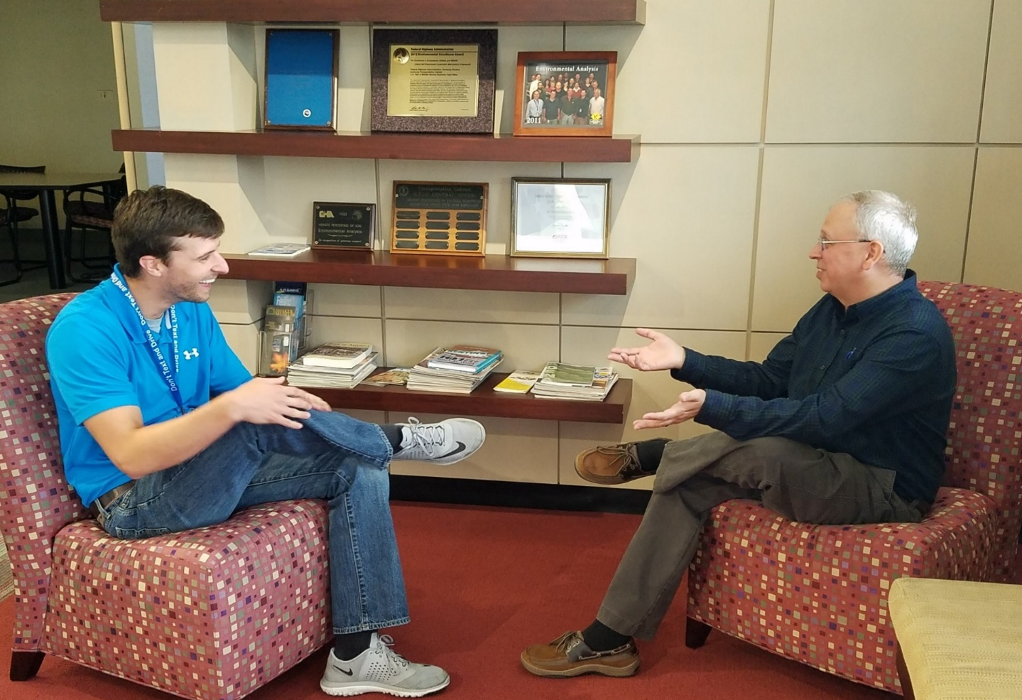

DES CSI: Aiding NEPA Decisions
I’m going to kill those Engineers!
Why doesn’t your DES match your CE?
We’re working on it …
Notes:
In 2017, in accordance with the KYTC/FHWA CE Agreement, FHWA conducted an audit of CE determinations made by KYTC to evaluate adherence to the Agreement in its processing of CE documents.

Slide 3

2017 Audit of CE’s
Identified Problems With:
  Purpose and Need
  Documentation of Comments and Coordination
  Identifying Commitments & Mitigation
  Specific documentation for each subject matter
  Missing signatures
Notes:
Purpose and Need is Really Important!
Sell upcoming P&N Training
Mention AASHTO Practitioners Guide 07 – Defining P&N and Range of Alternatives
A few issues were identified as a result of the audit, several of which were directly related to adequate justification and documentation of the project.
It is common practice to append the Design Executive Summary to the CE1 documents because it contains information that is important to the understanding of the project, as well as, the reasoning for decisions made for the project.
One item identified in the FHWA audit was that more of the information from the DES should be pulled into the body of the CE1 checklist, rather than to only provide a reference.
The CE1 should serve as a tool that documents and explains the project decisions and to justify why a particular alternative has been chosen.
A reader of the CE1 shouldn’t have to go digging in the Appendices to find the information needed to understand the project.
It was found that in some cases, pertinent project decisions weren’t documented well within the DES and since much of the information contained within the CE1 is taken from the DES, then there was an issue of having a consistent, well-documented, project record.

Slide 4

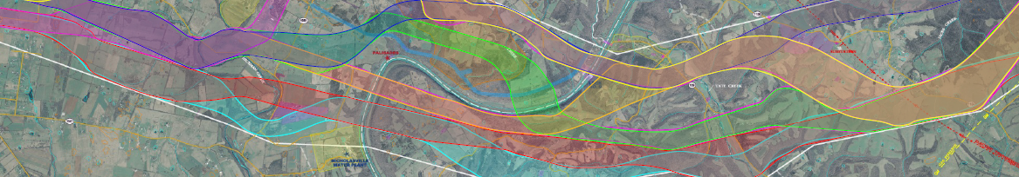
2017 Audit - Alternatives Analysis in the DES
  It’s an Analysis, not just a description
  All Alternatives mentioned in CE and/or Design Executive Summary (DES) need to be discussed
  Reasons for elimination need to be identified
  Reasons for selection must be clearly indicated
  Provide exhibits if carried beyond conceptual stage
Notes:
One of the main areas where improvement was recommended for the CE1 was the alternatives analysis. More often than not, when preparing a CE1, the document preparer either references the alternatives analysis from the DES or directly lifts a portion of it to put into the CE checklist.
If something is identified as a constraint to design, then discuss how each alternative impacts/avoids that constraint. For example, a historic property. Did one alternative avoid the property, but wasn’t favorable because of excessive excavation requirements? Did another alternative adversely impact the historic property but avoided extensive excavation? Did another alternate minimally impact the historic property, lessen excavation and still accomplish the P&N?
If a constraint is mentioned as being a factor in one alternative decision, address how it factored into the other design alternatives. It’s important to be able to compare the alternatives and the reasons and rationale that one alternative is determined preferable by the project team.

Slide 5


Highway Design
Guidance Manual (2017)
Section 203.6: The DES
Record of engineering decisions related to the project
No distinction between state-funded vs. federally-funded
Contains rationale concerning the identification of the preferred alternative and requested design exceptions
Used by the Division of Highway Design to determine if design exceptions can be approved
Notes:
So, let’s back up and take a look at how the DES is defined in the most current Highway Design Manual.
Note that items highlighted in red are directly related to and very useful for the CE document.
“All Pertinent Information used in the decision process” HD 203.6

Slide 6

Guidance Manual
(continued)
DES is used by Division of Environmental Analysis to determine environmental actions that may be required.
DES should fully document the rationale and all pertinent information used when making design decisions
Should be submitted after the PL&G

Slide 7

DES Summary Form
(Exhibit 200-09)
Notes:
Note the section on Page 2 where attachments are outlined.
#4 Purpose and Need
#5 Alternative Discussion (Decision Matrix)

Slide 8

DES Attachments
Typical Section (including bridge typical sections)
Project location map
Project overview and existing conditions
Purpose and need statement
Description and range of alternatives with respective traffic control schemes, and environmental, utility, and right of way impacts
Notes:
Existing Conditions
Define constraints
Examples of constraints: relocations, historic or arch sites, streams or wetlands, floodway, RR, terrain, utilities, property impacts, etc.
P&N – Helps Define Limits
Don’t try to make P&N fit every category of FHWA guidance (system linkage, capacity, transportation demand, social or economic development, legislation, modal interrelationships, safety, and roadway deficiencies)
What is the true purpose and what will demonstrate the need?
Use data to support the identified problems – existing and projected traffic numbers, accident history, LOS, planned development, horizontal & vertical deficiencies, etc.
Alts
Discuss how constraints influenced alternative development
Discuss the No Build and an alt that meets the approved Hwy Plan budget
If eligible bridge, make sure to discuss P4f alts (no-build, new location, & rehab)
Comparison matrix helpful
Exhibit illustrating alternatives helpful

Slide 9

DES Attachments (continued)
Discuss Design Exceptions, Variances & Mitigation Strategies
Cost comparison table of alternatives vs. Highway Plan (R, U, and C)
Reason for cost overrun (>15% or more)
Choice of preferred alternative and reasons for its selection
Discussion of clearzone
Consideration of bicycle and pedestrian facilities
Water-related impacts summary (Exhibit 200-08 in Design Manual)
Notes:
Cost Comparison and reasons for overrun
Include rough estimates for USACE ILF, USFWS IBCF, & other mitigation costs
Preferred Alt
Why select preferred compared to other alternatives?
For each alternative eliminated, clearly state why
Water-Related Impacts
Helpful in USACE ILF estimates and if floodway impacts are expected.
Additional design reviews if required

Slide 10
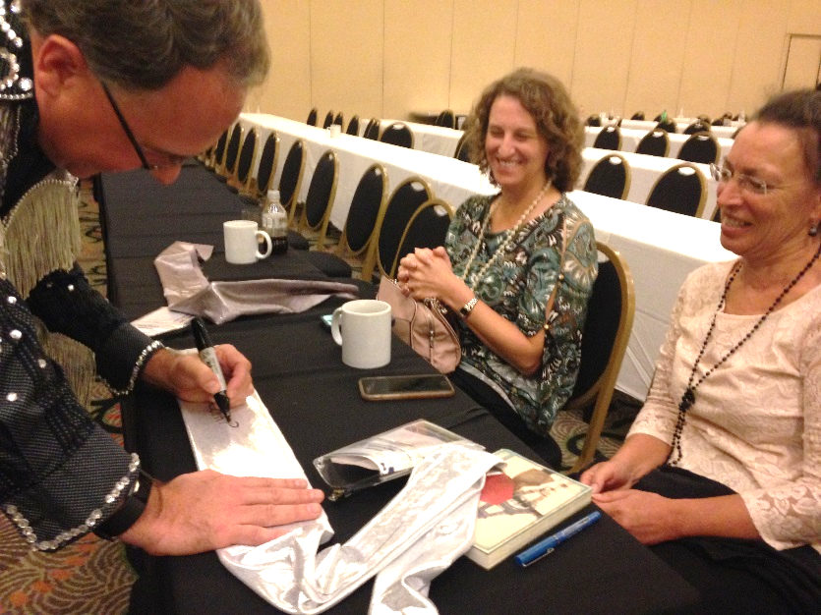
DES Approval Process
Tiered approach
Tier 1 – signed by Location Engineer
Tier 2 – signed by Roadside Design Branch Manager
Tier 3 – Signed by Director of the Division of Highway Design
Ideally, the DES approved prior to NEPA document approval
Alternatives in the DES, should also be discussed in the NEPA document
DES
Notes:
Tiered approval process is based on environmental document type, classification of roadway, ADT, design exceptions, and cost estimate
An approved DES is a record of project decision “buy-in” from KYTC management.
The DES and the CE1 should work in concert to demonstrate the P&N of the project, alternatives developed to satisfy that P&N, the reasoning/rationale for the preferred alternative, and ultimately, the selected alternative.
Both documents should be consistent with one another and should serve as documentation of the project record.
Therefore, involve the DEC in the DES development and/or review to ensure consistency and adequate documentation for the CE1/project record.

Slide 11

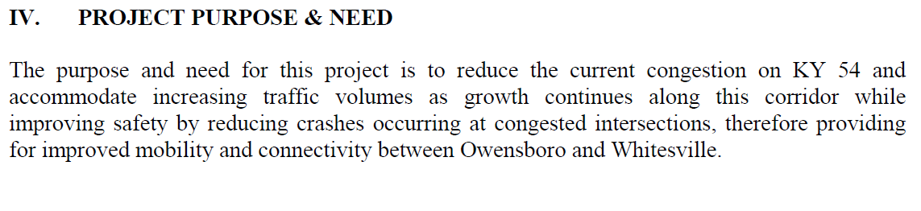
Example Project
State Funded – Recommended Alternative was identified prior to applying federal funds – essentially widening along the existing route
Notes:
This project was generally well documented – with good public involvement exhibits and project team meeting minutes
But, there were gaps in the record, particularly in how the alternatives were analyzed and selected.

Slide 12
Example – Alternatives Analysis
Six Build Alternatives
Variations of widening about centerline, to the left and right
Variations on Median vs. TWLTL
Matrix compared construction costs, ROW impacts, and utilities affected by each alternative
Did not consider environmental resource impacts
Notes:
DES did a good job of describing alternatives, but not much discussion on why certain alternatives were eliminated.

Slide 13
Example - No Build Alternative
This alternative would maintain the present roadway system with no improvements to KYXX. All of the current problems associated with this section of roadway, such as capacity deficiencies and the need to address safety would remain and be further strained with any future increase in average daily traffic as well as any future development. This option does not meet the purpose and need for the project.
Notes:
Great job tying back to purpose and need by mentioning specific needs that will not be met

Slide 14
Example –
Recommended Alternative
After holding a Preliminary Line and Grade Meeting, the design team recommended moving forward with a combination of Alternates 1A and 2A. This option best meets the purpose and need of the project by addressing the current and projected needs of the facility while providing a quality product to the driving public.
No support for how or why it best meets P&N
Notes:
Trust me – we’re providing a quality product!

Slide 15
Example - Comments from CE Review
Did all the alternatives receive the same amount of consideration?
Were there some that were eliminated much earlier?
Document the reasons for Alternatives being eliminated
Notes:
The reasons stated in the DES did not provide adequate justification for the decision in NEPA

Slide 16
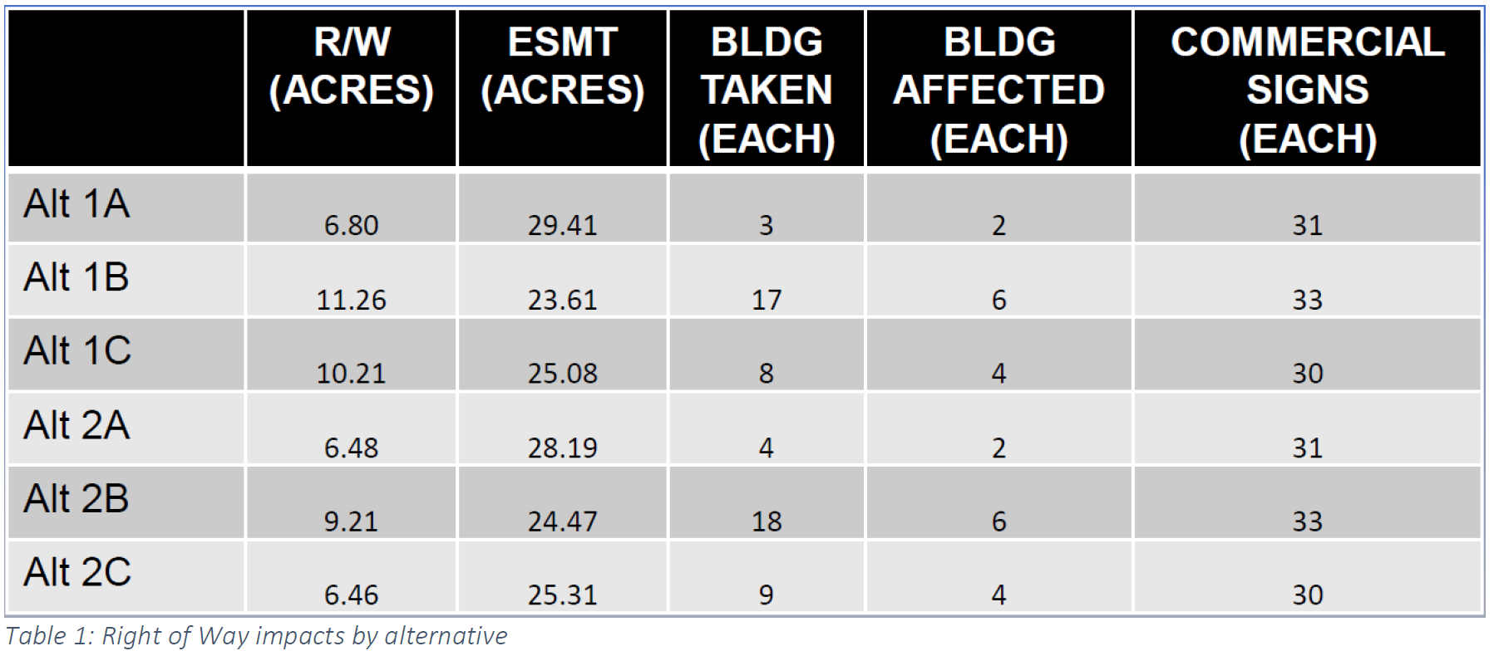
Example - Alternatives Eliminated
Further discussion w/ Project team identified ROW impacts as being key to eliminating several alternatives
“… widening to the north or south (B and C Alternatives) would have much greater property impacts. … For this reason, Alternatives 1B, 1C, 2B and 2C were eliminated from further consideration.”
Notes:
The data was there, it just hadn’t been explained in the DES, or in any other project documentation.

Slide 17
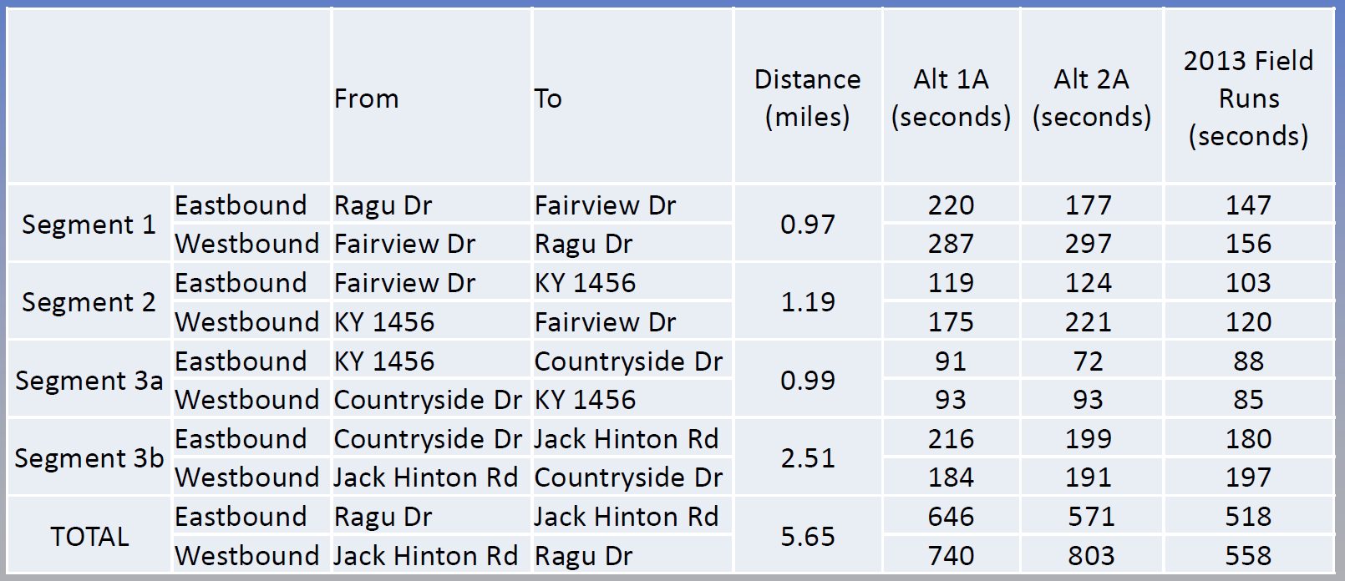
Travel Time Analysis from PL&G
Example: Does Solution
Improve Congestion?
No comparison to baseline conditions - Existing and 2040 No-Build Travel Times could not be found!
Notes:
We found travel time data in a PL&G slide deck, but there was no data to compare it to. Without existing and no-build travel time data, it isn’t clear whether these alternatives meet the P&N

Slide 18
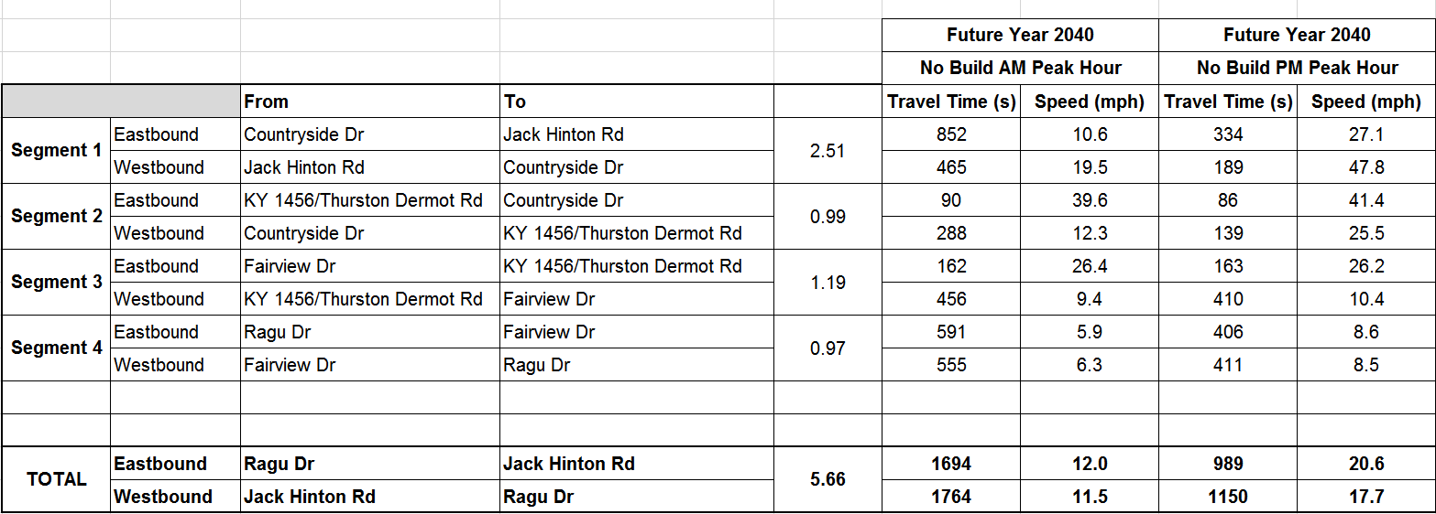
The 2013 Traffic Analyst
Was Consulted
This data had to be recreated!
Notes:
We had to ask the prime consultant go back to the traffic sub-consultant and dig into their old files to recreate this data. This took a couple of weeks, but luckily, the data was still available.

Slide 19
This Data was then combined with the PL&G Travel Time Data
 | 2013 Field Runs
 | AM Peak Hour |  | PM Peak Hour
 | Travel Time (seconds) | Speed (MPH) | Travel Time (seconds) | Speed (MPH)
Eastbound | 475 | 43 | 518 | 39
Westbound | 512 | 40 | 558 | 36
 | No Build Future Year 2040
 | AM Peak Hour |  | PM Peak Hour
 | Travel Time (seconds) | Speed (MPH) | Travel Time (seconds) | Speed (MPH)
Eastbound | 1694 | 12 | 989 | 20.6
Westbound | 1764 | 11.5 | 1150 | 17.7
 | Alternative 1A Future Year 2040
 | AM Peak Hour |  | PM Peak Hour
 | Travel Time (seconds) | Speed (MPH) | Travel Time (seconds) | Speed (MPH)
Eastbound | 708 | 29 | 646 | 32
Westbound | 891 | 23 | 740 | 28
Notes:
Finally, we put all the data together to show the improved travel times for the selected alternative.

Slide 20
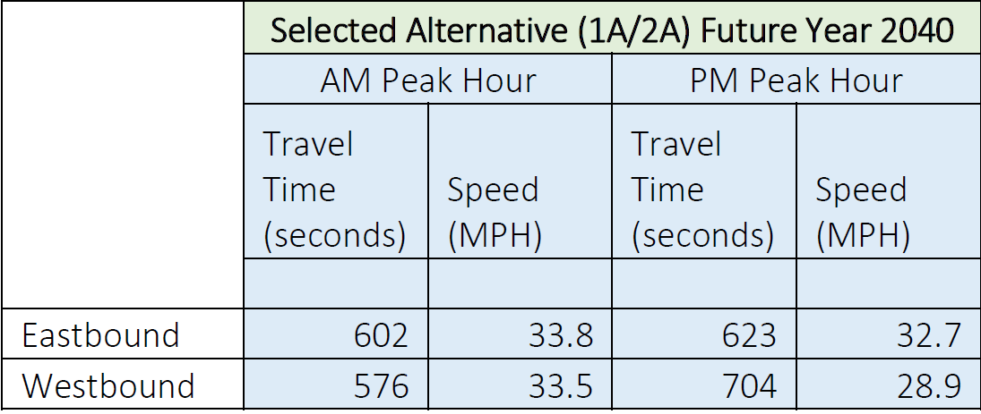
Example - Selected Alternative
The selected Alternative best meets the purpose and need of the project by providing the best congestion relief and addressing the current and projected needs of the facility.
Notes:
Now we could truthfully state that this alternative best met the P&N

Slide 21
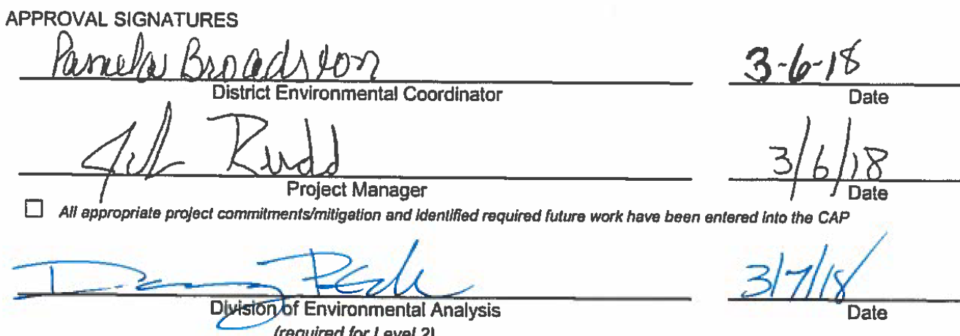
Success! CE Approved!
Notes:
With the decision documented and explained, the CE could be signed.

Slide 22


KY 7 DES
Reconstruction from Sandy Hook toward Wrigley
Elliott and Morgan Counties, Item 9-228.00
Purpose - To improve the safety issues along KY 7 between Sandy Hook and Wrigley, such as geometric deficiencies, a non‐standard roadway template, inadequate clear zones, and the lack of proper sight distance at intersections and access points.
A goal is to provide an improved system continuity and mobility between the communities of Grayson and West Liberty, in conjunction with other past and programmed projects.
Notes:
Address numerous substandard horizontal and vertical curves (54), limited sight distance (195 access points along the project), limited shoulders (1’-3’, where they exist), and high accident rates (25% of the length of the project had a CRF>1.00) along a 10.2 mile portion of KY 7.

Slide 23
KY 7 DES
A Design Executive Summary was prepared for the project and submitted after the Preliminary Line and Grade meeting.
District 9 had several comments:
Make the purpose and need match the NEPA document
Include mapping to show the alternatives
Ensure that impact discussions match the NEPA document

Slide 24
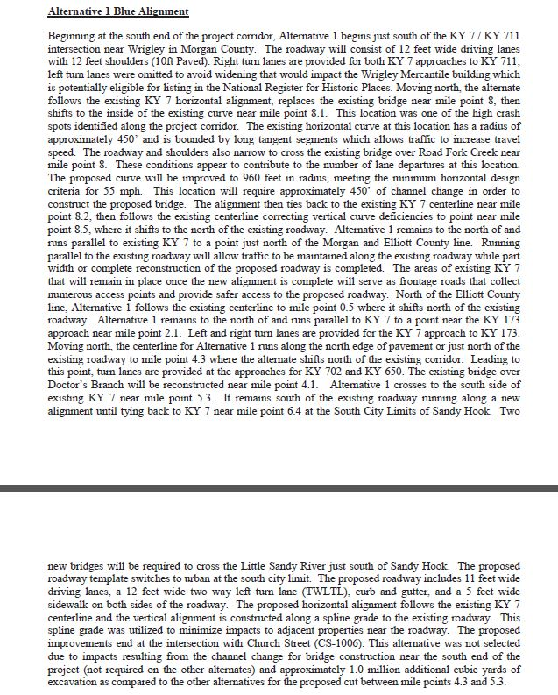
KY 7 DES
The project team engaged the NEPA members to assist in editing the DES. Project discussions and the Purpose and Need were coordinated, mapping from the NEPA document was added, and the team addressed all of the District’s comments.
Notes:
Alternative descriptions include design logic, including curve radii, travel speeds, accident root cause analyses and solutions. It also includes technical language “spline grade”, and a lot of directional words to describe 10.2 miles of road, such as: runs parallel, shifts north, crosses, remains south. Positive is it discusses why the alterative was not chosen (channel changes not required by the other 2, and 1.0 million cubic yards of excavation compared to the other 2 alternatives.

Slide 25
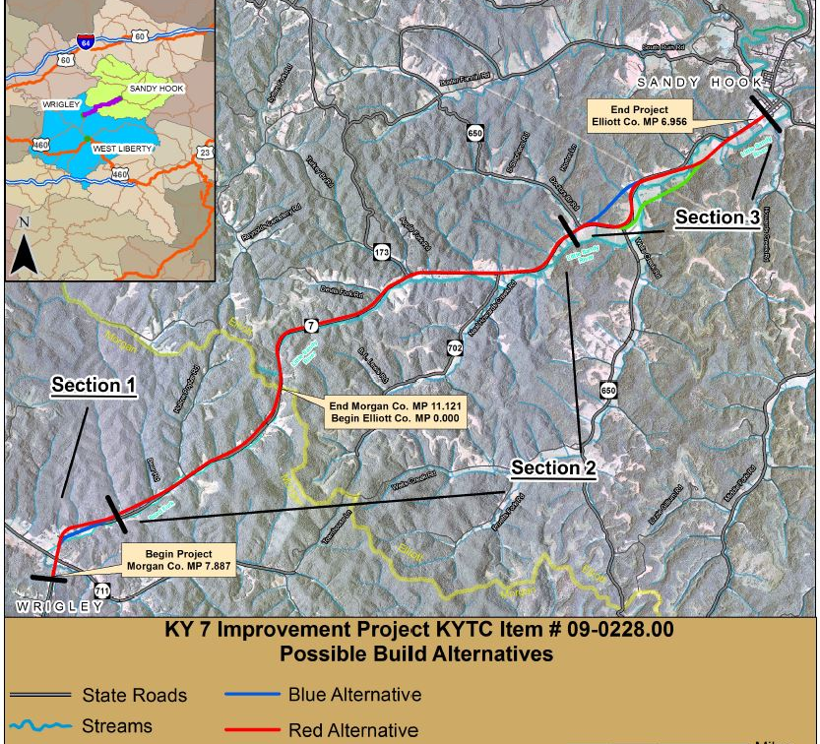
KY 7 DES
NEPA staff provided exhibits that had been developed for the baseline studies and Categorical Exclusion for use in the DES.
Notes:
They say a picture is worth a thousand words, in this case it was only worth 971 ☺

Slide 26
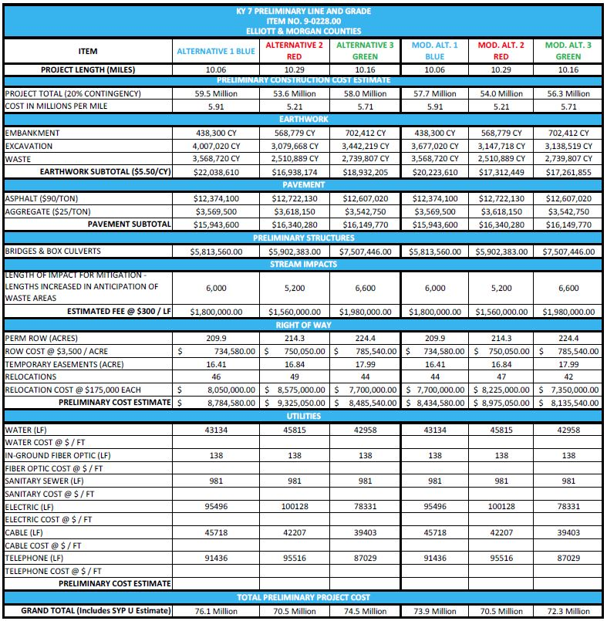
KY 7 DES
Environmental documents and reports were used to provide project impact detail for use in the DES, including stream and wetland impacts (used to complete the Water Related Impacts Summary portion of the DES).
In lieu fee estimates were generated and included in the DES to assist in project cost planning.
Notes:
From earlier discussion “Include rough estimates for USACE ILF, USFWS IBCF, & mitigation costs”

Slide 27
KY 7 DES
The NEPA review of the DES identified a cost saving measure:
All three alignments avoided what was believed to be a historic store
It had been determined that the store was not eligible for the National Register of Historic Places
All three alternatives were revised to reduce earthwork in this location by 330,000 cubic yards
Also able to avoid two relocations and potential cemetery impacts
Notes:
The second tweak with revised alignments was located near mile point 10.7 in Morgan County. All three alignments followed the same route at this location. They were originally located approximately 130 feet north of the existing centerline to minimize impacts to the Smith’s Grocery building. This building was identified as potentially eligible for inclusion in the National Register for Historic Places during early alignment development. After further review, this structure has been deemed not eligible. The proposed alignments were shifted to the north edge of the existing roadway at this location. This revision reduced roadway excavation by approximately 330,000 cubic yards, and avoids two relocations and potential impacts to a cemetery.
A review of the DES by the NEPA team will highlight design decisions that were made that are avoidance or minimization measures that the KYTC should “get credit for” and be documented in the P&N. There is a link to the design decision making process that absolutely should be captured in the NEPA document. Designers took environmental information to make the design better and environmental needs to capture that in the NEPA document. More than we shifted off…
The main take-away is that the design team and the NEPA team should coordinate and work together on the DES to accurately account for design decisions and alternative impact and selection analyses. The PL&G is when this stuff comes together naturally in the process for design and environmental and working together increases of getting a signed DES.
We are working to improve the information and documentation of the design decision making process to improve readability and to include the necessary information.

Slide 28
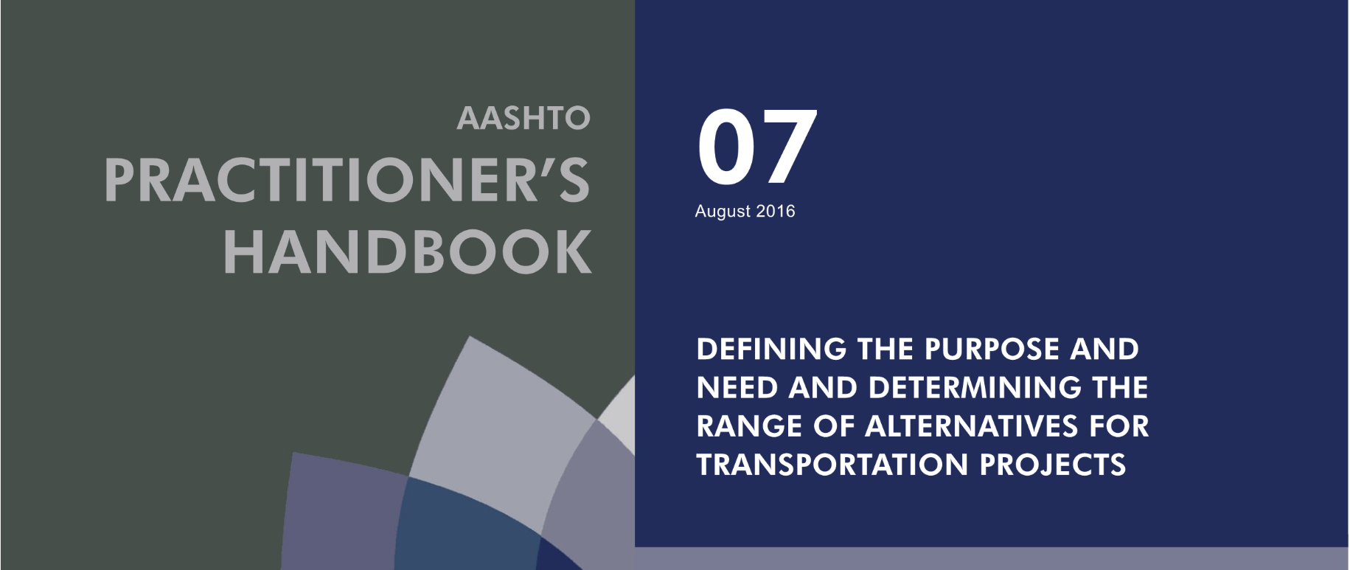
Resources & Best Practices
The project can benefit from a thorough review of the DES by NEPA team members
Updated Design Manual Guidance
AASHTO Practitioner’s Handbook
Invite NEPA team members to assist with the development of the DES
Use clear language and exhibits to document and explain the project decisions
Use the same language and exhibits in NEPA documentation
Upcoming Purpose and Need Training
Notes:
The second tweak with revised alignments was located near mile point 10.7 in Morgan County. All three alignments followed the same route at this location. They were originally located approximately 130 feet north of the existing centerline to minimize impacts to the Smith’s Grocery building. This building was identified as potentially eligible for inclusion in the National Register for Historic Places during early alignment development. After further review, this structure has been deemed not eligible. The proposed alignments were shifted to the north edge of the existing roadway at this location. This revision reduced roadway excavation by approximately 330,000 cubic yards, and avoids two relocations and potential impacts to a cemetery.
A review of the DES by the NEPA team will highlight design decisions that were made that are avoidance or minimization measures that the KYTC should “get credit for” and be documented in the P&N. There is a link to the design decision making process that absolutely should be captured in the NEPA document. Designers took environmental information to make the design better and environmental needs to capture that in the NEPA document. More than we shifted off…
The main take-away is that the design team and the NEPA team should coordinate and work together on the DES to accurately account for design decisions and alternative impact and selection analyses. The PL&G is when this stuff comes together naturally in the process for design and environmental and working together increases of getting a signed DES.
We are working to improve the information and documentation of the design decision making process to improve readability and to include the necessary information.

Slide 29
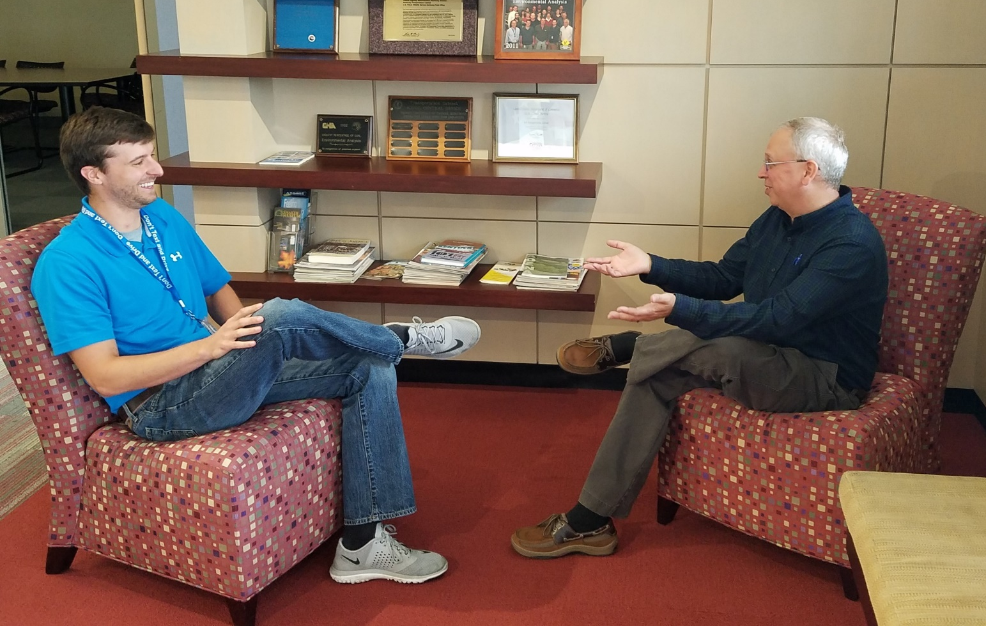
Are We Good?
You Totally Rock!
…Thank You!

